Slide 1
Christopher S
IS362 Data Acquisition and Management
Final Project
5/12/22
Spotify Top 100 2022

Slide 2
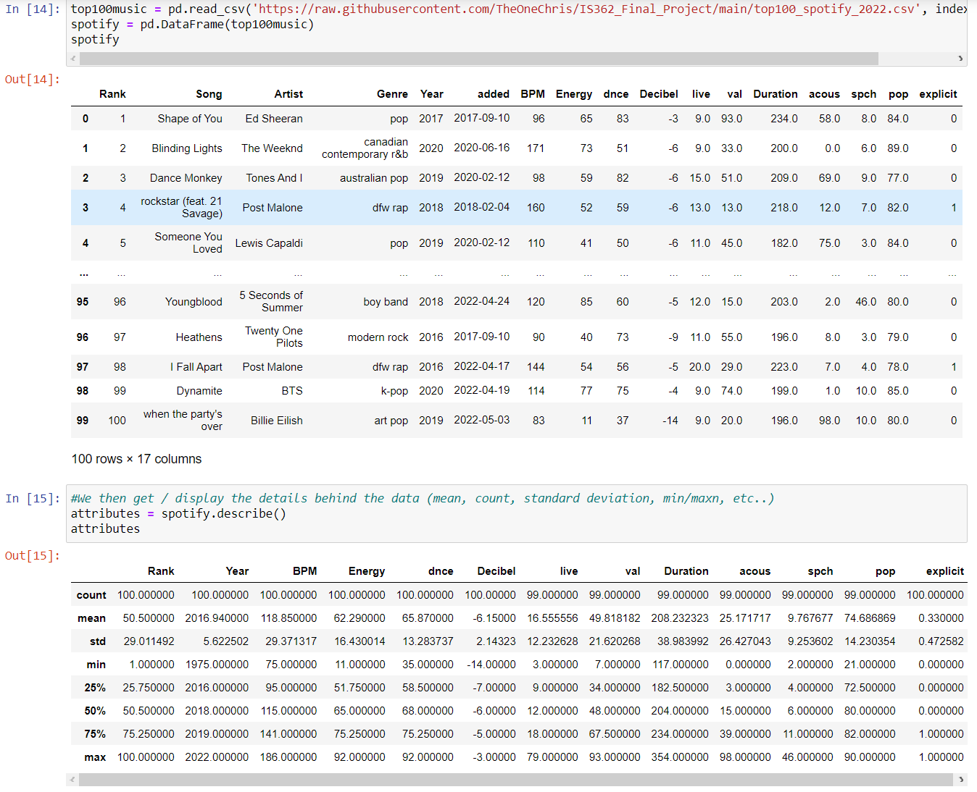
Here I import the top 100 Spotify 2022 file I created to populate the data that will be analyzed
Here I display some details behind the data, showing different statistics

Slide 3
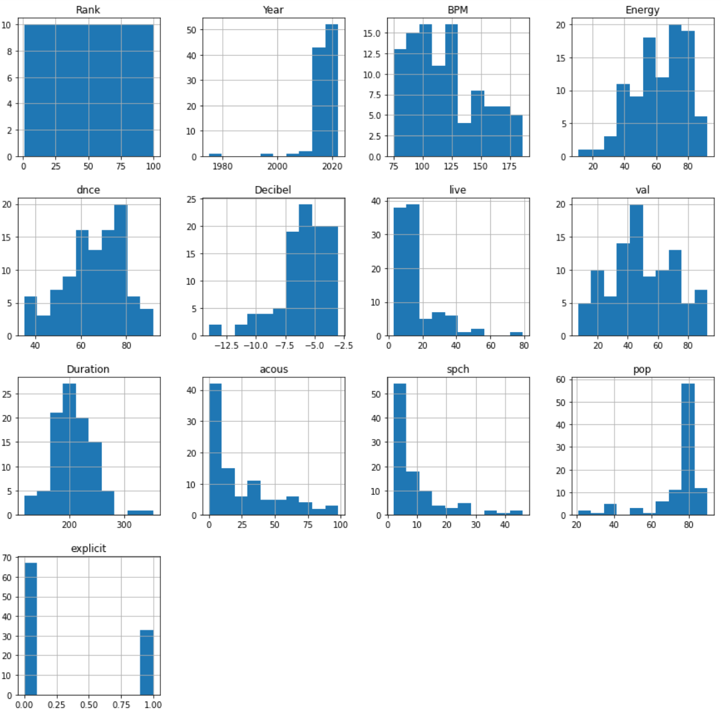
Here I display the histograms for each data type

Slide 4
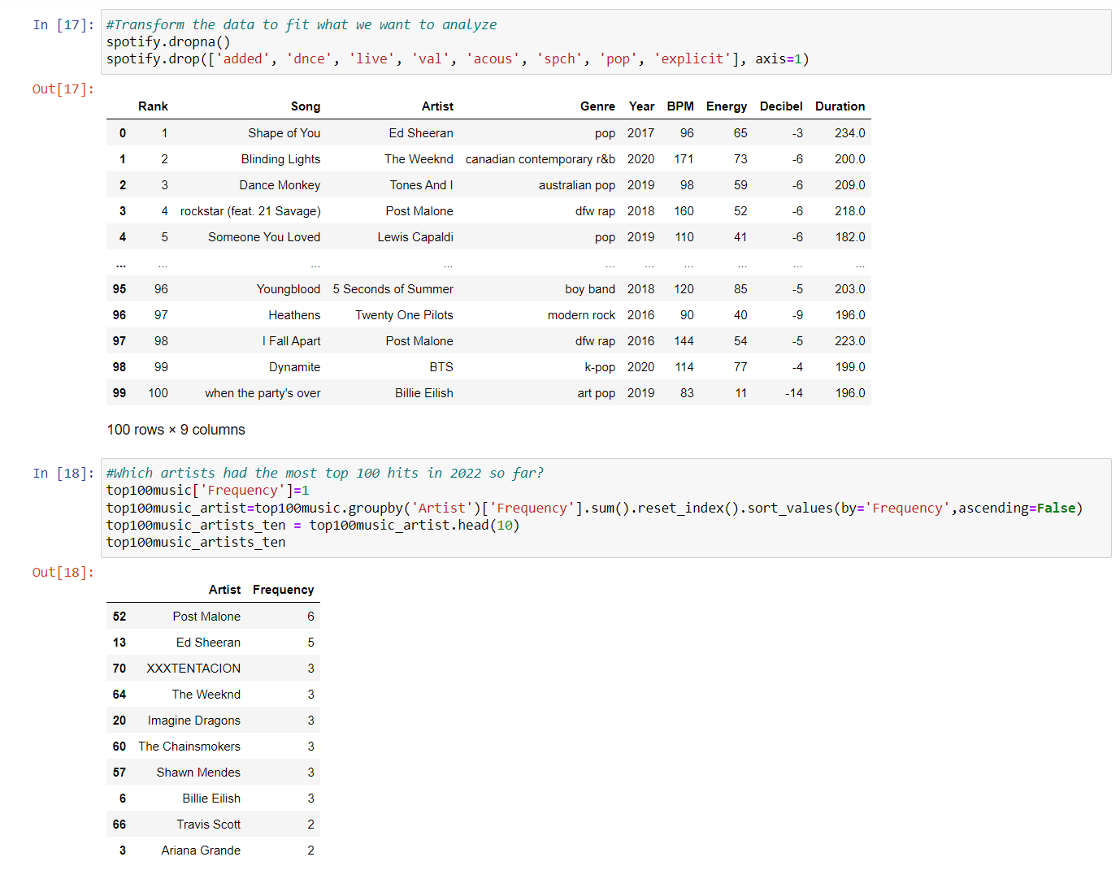
In this part I drop the data columns I won’t be working with
Here I display the Frequency of top 10 artist in the top 100

Slide 5
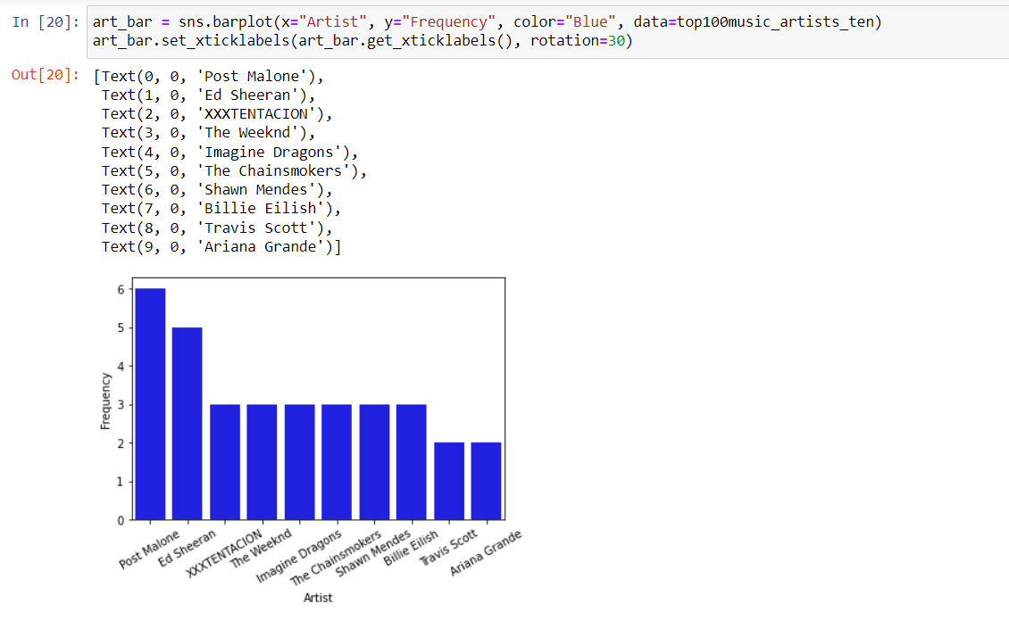
Here I display the Frequency of the top 10 in chart form

Slide 6
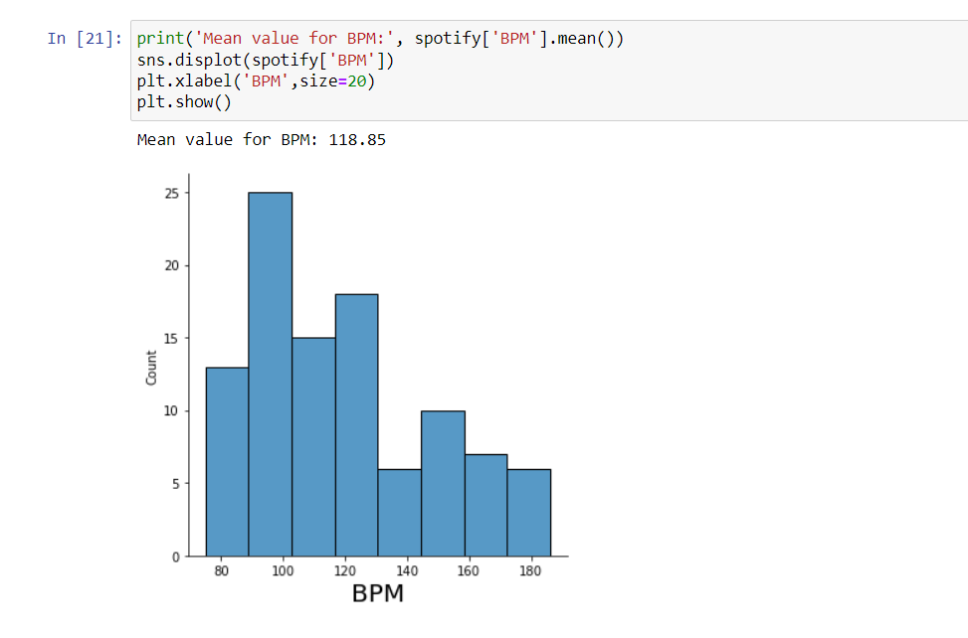
We look at the mean value data behind the BPM data, which turns out to be a BPM of 118.85

Slide 7
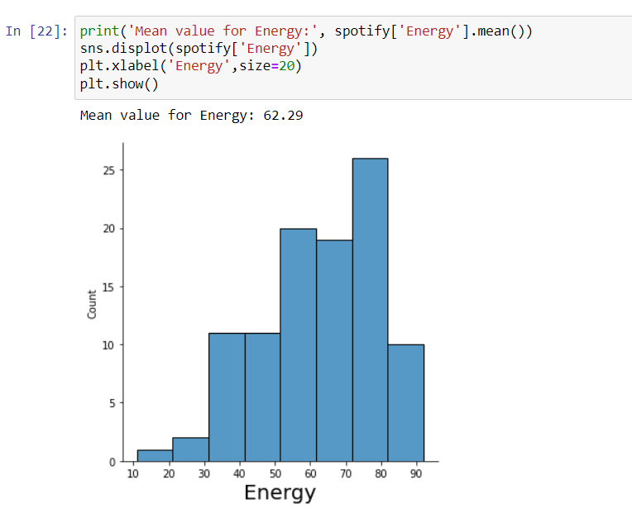
We look at the mean value data behind the Energy data, which turns out to be an Energy of 62.29

Slide 8
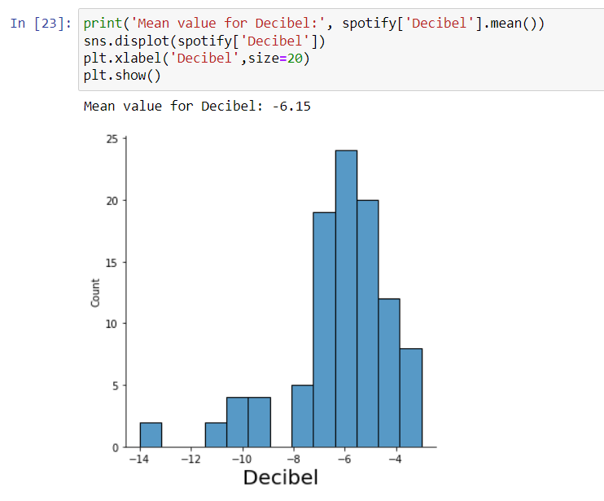
We look at the mean value data behind the Decibel data, which turns out to be a Decibel value of -6.15

Slide 9
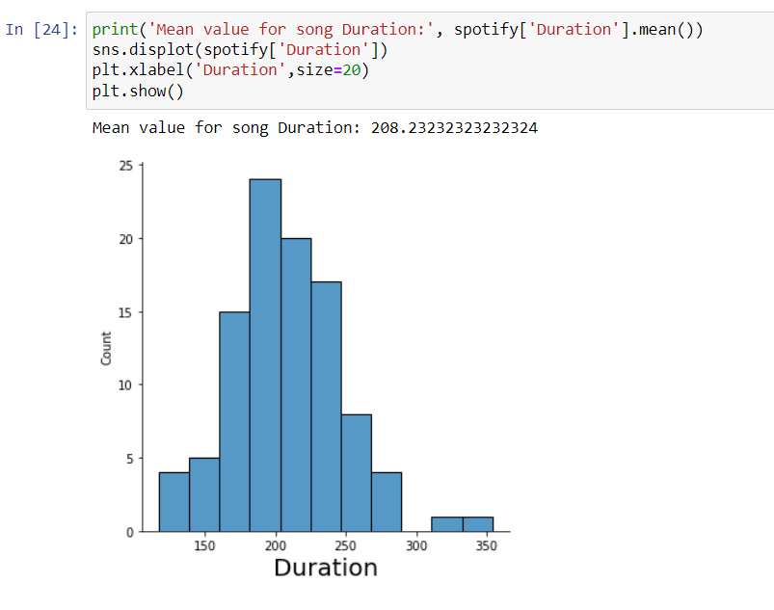
We look at the mean value of the Duration data, which is 208.24 seconds

Slide 10
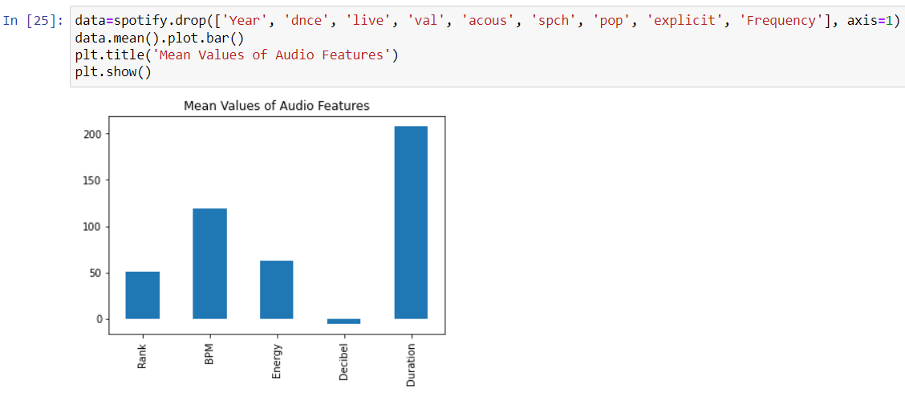
Conclusion
Finally, we look at the different mean values charts and draw some conclusions from looking at the 3 main music attributes we have BPM, Energy, Decibel. Firstly, we the songs the BPM which is the highest value, which means that the tempo speed of the music is very fast. Following BPM, we have Energy statistic which speaks to the traversing of sound waves. Then lasty, we have the Decibel statistic which measures the sound pressure level. These mean levels for each are related to music types like “Dance” or “Rap”. Leading me to believe that the top 100 songs in 2022 are mainly in the “Dance” or “Rap” genre.

